Slide 1

Difference in service usage by members and casuals
Presented by : Samyak jain
Last updated : September 1st 2023

Slide 2
Table of content
Purpose Statement (Objective of the Study)
Some Interesting Findings of the Study
Conclusion

Slide 3
How do annual members and casual riders use cyclistics bikes differently?
OBJECTIVE

Slide 4
We mainly used number of rides and average ride duration data from the company records to assess the difference between the members and casuals

Slide 5
FINDINGS of the study

Slide 6
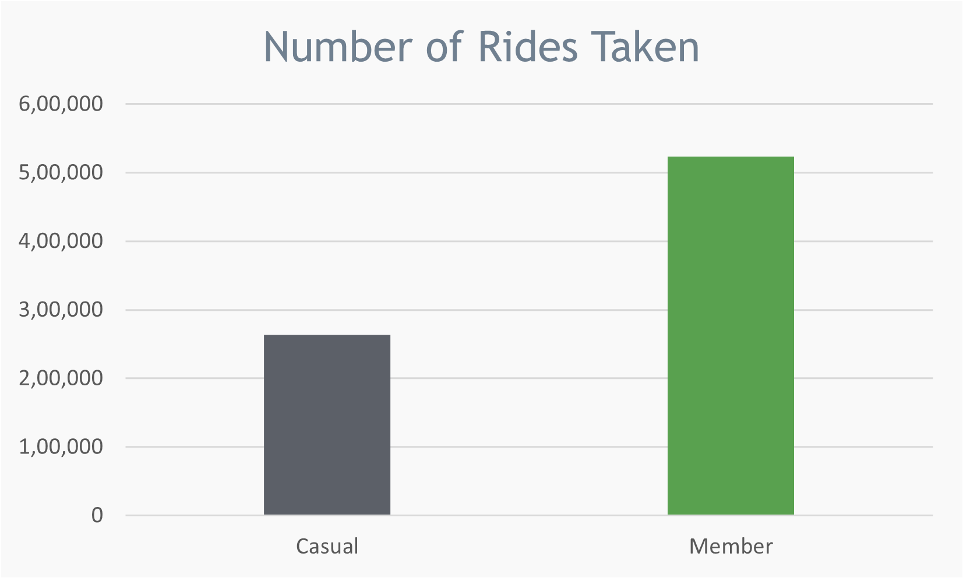
Number of rides taken by both, yearly total
Members are more likely to take rides, as show by the data they take almost twice as many rides, compared to casuals.

Slide 7
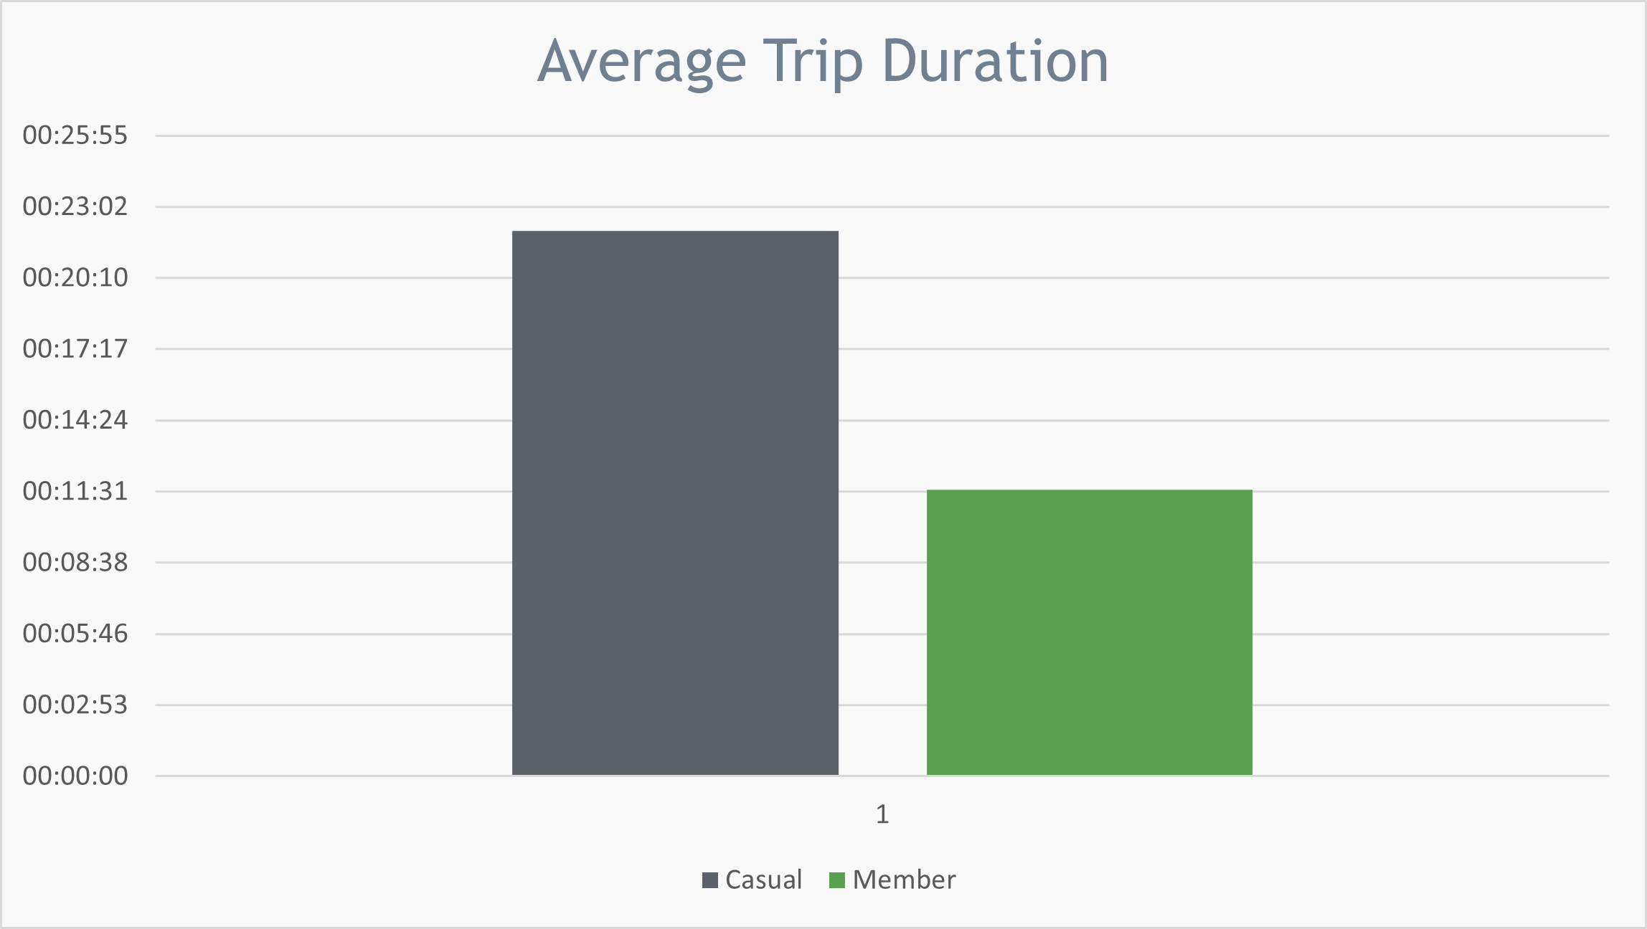
Average trip duration of rides taken by both, yearly total
The average ride duration of entire data was 15 minutes and 06 seconds, which is more than the average of members but less than the average of casuals.
Casuals tend to take longer trips, whereas members are more flexible in their trips , as they make trips more often but of shorter durations.

Slide 8
Difference in usage?
For members, seconds spent using the bike : 11x60 + 36 = 696 seconds, which when multiplied by number of rides taken by them (5,23,141) , comes to be around 4214.2 Days,
And for casuals, 1323 seconds multiplied by 2,63,279 rides comes to be 4031.5 Days ,
Which means despite the lower ride durations, members are using the bike services more than the casuals, on an average of almost 200 more days yearly.

Slide 9
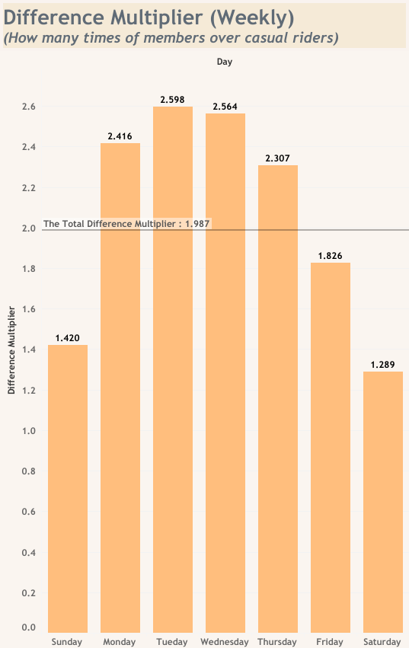
Weekly difference multiplier
On the Fridays, Saturdays and Sundays, the difference multiplier between the casuals and members drops below the total difference multiplier.
Implying, that on these three days, members are less likely to rent a bike whereas casuals are more likely to use bikes on weekends.
One way this could be interpreted is that office workers or college students usually need memberships to attend their offices or institutions on the weekdays
Notes:
A difference multiplier is the total number of rides taken by members (on a particular condition, like on each day of the week in this case) divided by the total number of rides taken by casual on the same condition. The total Difference Multiplier is the same calculation but on the general level, i.e. on the yearly rides takes. For example here in this chart, the total number of rides taken by members on sundays throughout the year divided by the total number of rides taken by casuals on sundays throughout the year comes out to be 1.420 , which means the members use the bikes 1.4x more than the casuals on sundays, and so on.
The total multiplier is just the total number of rides taken by members throughout the year divied by the total number of rides taken by casuals throughout the year.

Slide 10
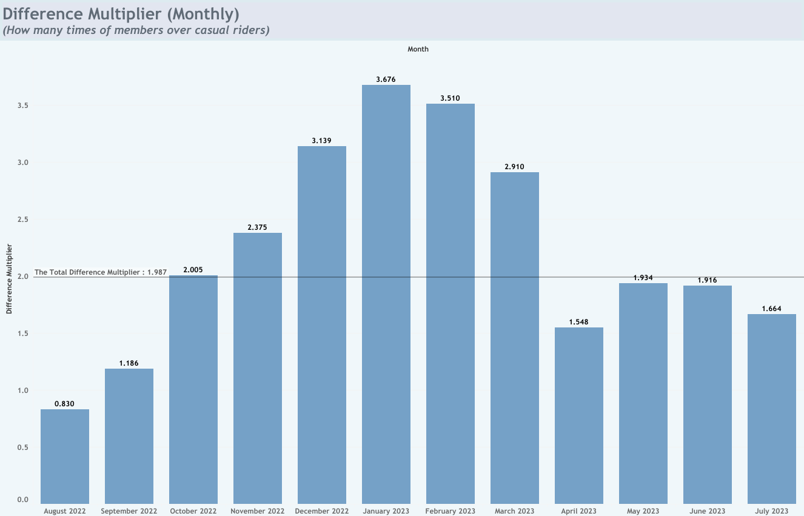
Number of rides taken by both, yearly total
Members tend to use bikes WAY MORE than casuals in the winter seasons, whereas the difference multiplier in hotter months is equal to or lower than the total difference multiplier.
One way to asses this information could be that in winters, people buy membership to stay warm and fit. Or that people just don't prefer using bikes in hot months, probably due to better alternatives like car, which can keep them cool while driving.
Notes:
Here, the same concept of difference multiplier is used, but on months.

Slide 11
Conclusion
Members tend to use bikes way more, but for shorter durations, and on the total their usage is much more than that of casuals.
Members tend to use bikes more often from Tuesdays to Thursdays, and in the months from November to march.
My personal recommendations based on the analysis would be :
To lower the prices of membership in the hotter seasons to better cater to the casuals.
Casuals are already taking many rides, so to run better advertisements to make them aware of the benefits of membership.

Slide 12
Thank you

